Slide 1

CENTER FOR VLSI DESIGN RTL IMPLEMENTATION OF BASIC DDR5 MEMORY READ & WRITE CONTROLLER
Presented By :
24211A0418 Avula Hasini Priya
24211A0434 Bemalkhed Anushka
24211A0463 Dinne Manideepika
25215A0401 Dadapuram Akshay Reddy
Guided by:
Dr.U. Gnaneshwara Chary , M.Tech, Ph.D Assistant Professor

Slide 2
AIM OF THE PROJECT :
To design a simple RTL-based controller that demonstrates how DDR5 performs basic read and write operations without involving the full complexity of commercial memory controllers.

Slide 3
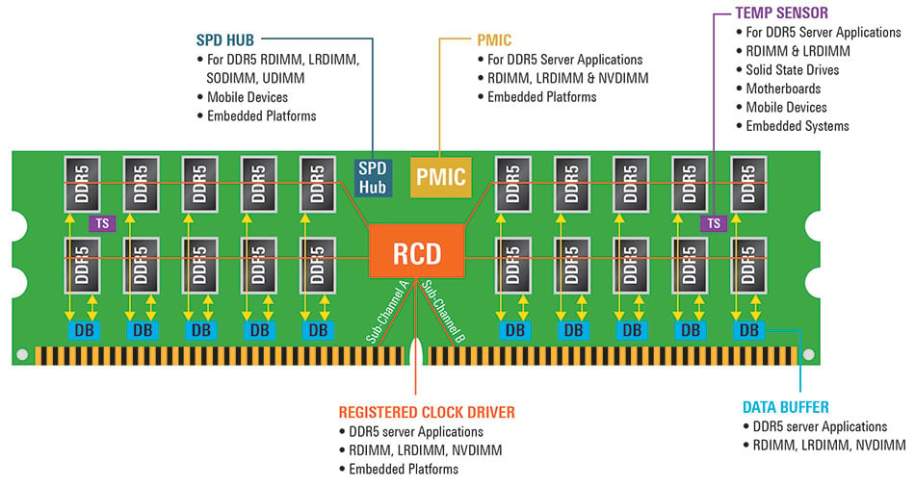
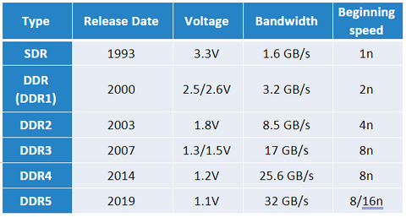
INTRODUCTION :
DDR5 is the latest generation of DRAM designed to provide much higher speed, efficiency, and performance compared to previous DDR memory technologies.
It uses dual 32-bit channels instead of a single 64-bit channel, allowing faster and more flexible data transfers.
DDR5 supports higher data rates (up to 8400 MT/s and beyond), making it ideal for AI, servers, gaming, and high-performance computing.
It includes on-die ECC and on-DIMM power management (PMIC) to improve reliability and power efficiency.
DDR5 increases bandwidth, capacity, and parallelism through features like BL16 burst length and 32 memory banks.

Slide 4
PROBLEM STATEMENT :
Understanding DDR5’s real read/write flow is challenging due to its high-speed commands and tight timing rules. The problem is to build a practical and accurate representation of how DDR5 handles data during read and write operations, making the internal process clear and accessible.

Slide 5
OBJECTIVES :
1. To design RTL modules that implement DDR5 SDRAM Read and Write operations.
2. To implement the necessary command and control sequencing in RTL.

Slide 6
Literature Survey
SI no | Title | Year of publication | Name of Journal/ authors | Existing design Description | Limitations
1 | "Next-generation DDR5 RAM will double the speed of DDR4 in 2018" | March 31, 2017 | Cunningham, Andrew | It is built using high-density memory cell arrays integrated on silicon for efficient read and write operations. | mainly discusses future expectations, so it lacks clarity on real-world challenges in achieving those projected speeds.
2 | "DDR5 Memory Standard: An introduction to the next generation of DRAM module technology" | January 2024. | Kingston Technology | Explains the finalized DDR5 standard focusing on PMIC integration and dual-channel DIMM architecture | focuses on features of the standard but does not address practical integration issues when using DDR5 in actual systems

Slide 7
REVIEW COMMENTS BY PANEL MEMBERS
Based on the previous review, all the suggestions given by the panel members were carefully incorporated. The presentation now includes clearer architecture, better justification of design decisions,and updated performance analysis

Slide 8
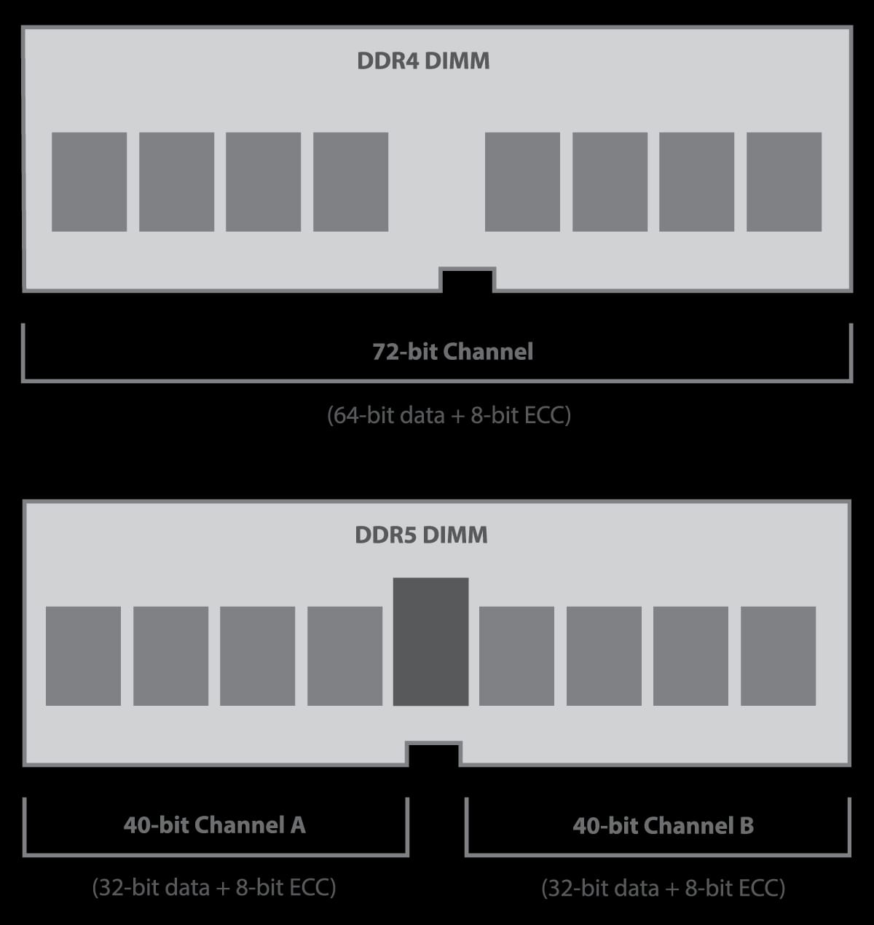
Existing DDR (DDR1–DDR4) Read/Write Limitations
Single-channel & fewer banks : limited parallel reads/writes, high bank conflicts, and frequent stalls during operations.
Small burst lengths (BL4/BL8) : lower data throughput per command and inefficient utilization of high-speed buses.
External power management & no on-die ECC: signal noise, timing instability, and higher error rates during high-speed read/write transfers.
Blocking refresh & basic training : read/write pauses during refresh cycles and reduced reliability at multi-gigabit speeds.

Slide 9
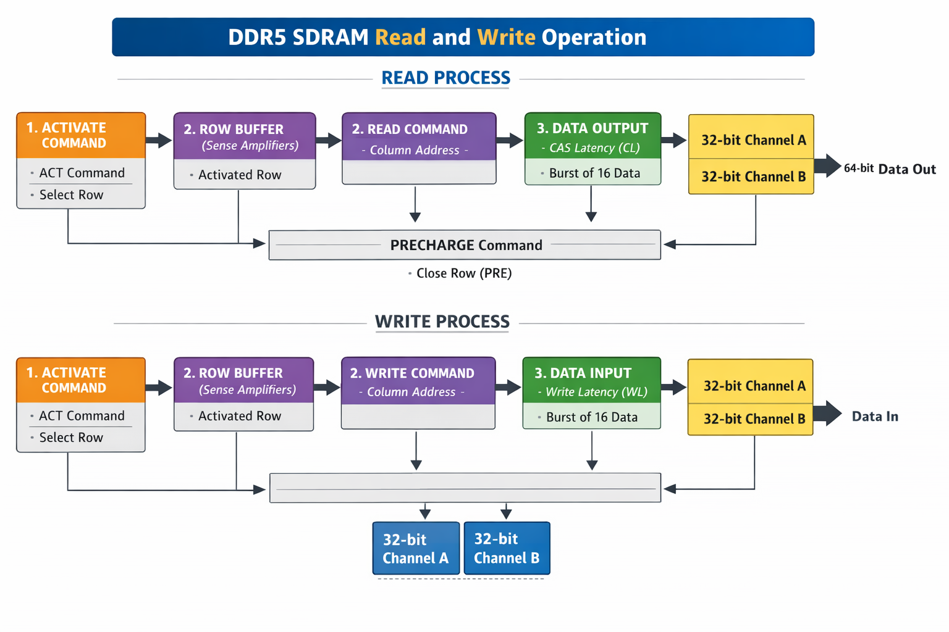
PROPOSED SOLUTION
Build a minimalistic RTL controller focusing only on:
Accepting read/write requests
Generating basic commands
Sending addresses and capturing data
Implementing a clean FSM for operations
Provide a structure that can be extended later to include refresh, banks, or burst-length variations.

Slide 10

TOOLS :
Xilinx Vivado for design entry, RTL coding, and simulation.
Verilog HDL for writing the controller logic and FSMs.
Waveform Analyzer (Vivado / ModelSim) for verifying read/write sequences.

Slide 11
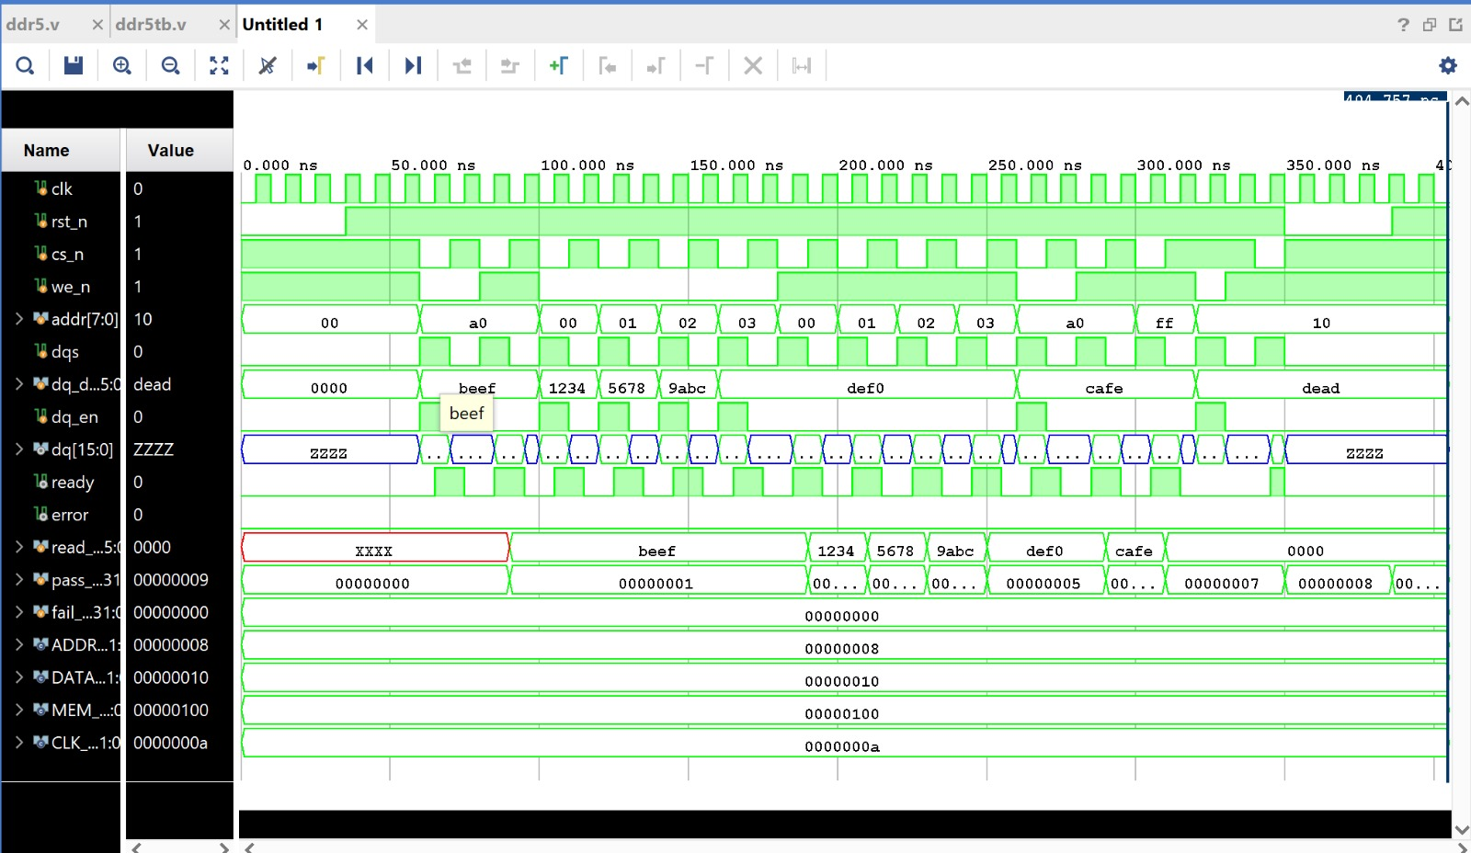
Results RTL SIMULATION OUTPUT

Slide 12
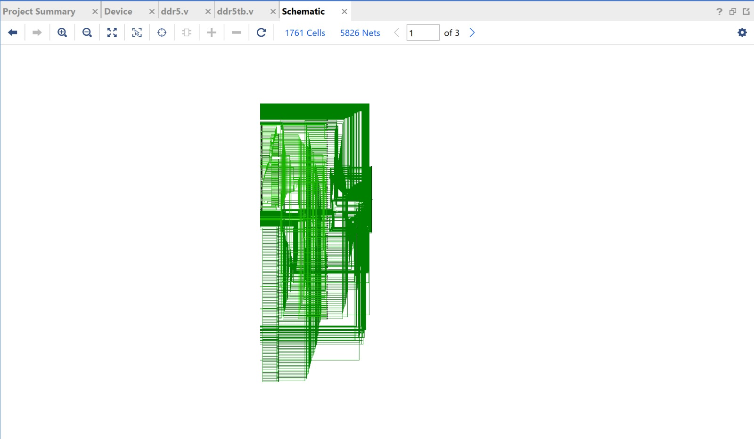
RTL SCHEMATIC VIEW

Slide 13
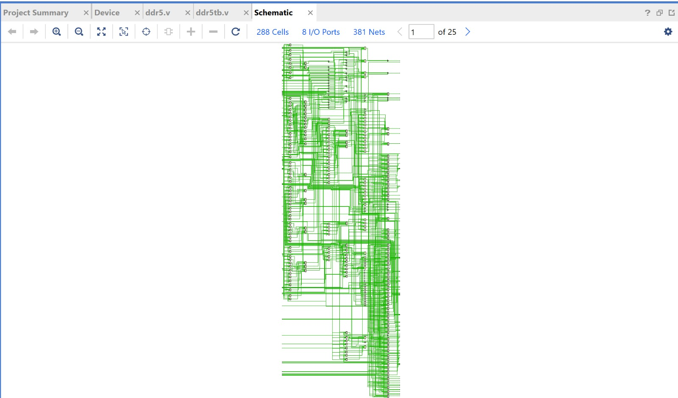
SYNTHESIS OUTPUT

Slide 14
REFERENCES :
Cunningham, Andrew (March 31, 2017).” Next generation DDR5 RAM will double the speed of DDR4 in 2018”
Liu, Zhiye (July 15, 2020). "DDR5 Specification Released: Fast RAM With Built-In Voltage Regulators"
Dr. Ian Cutress (October 6, 2020). "Insights into DDR5 Sub-timings and Latencies"
Manion, Wayne (March 31, 2017). "DDR5 will boost bandwidth and lower power consumption
DDR5 Memory Standard: An introduction to the next generation of DRAM module technology". Kingston Technology.

Slide 15
THANK YOU

